Slide 1
Numerical Differentiation
AMSC/CMSC 460
Dr. Christopher Moakler

Slide 2
What is a derivative?
This isn’t rhetorical.

Slide 3
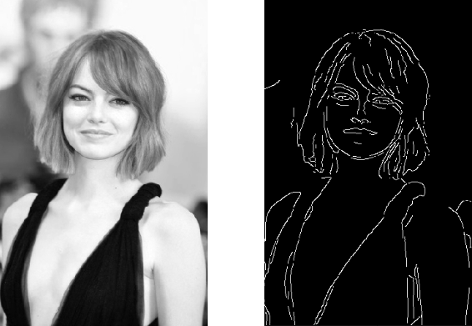
Why do we use derivatives?
Some physical formulae call for derivatives.
We are often interested in rates of change on their own merit.
We will need to approximate derivatives with computers when we study ODEs.
Edge detection can be accomplished by taking the gradient of an image.
https://towardsdatascience.com/canny-edge-detection-step-by-step-in-python-computer-vision-b49c3a2d8123

Slide 4
What’s harder? Taking a Derivative or an Integral?

Slide 5
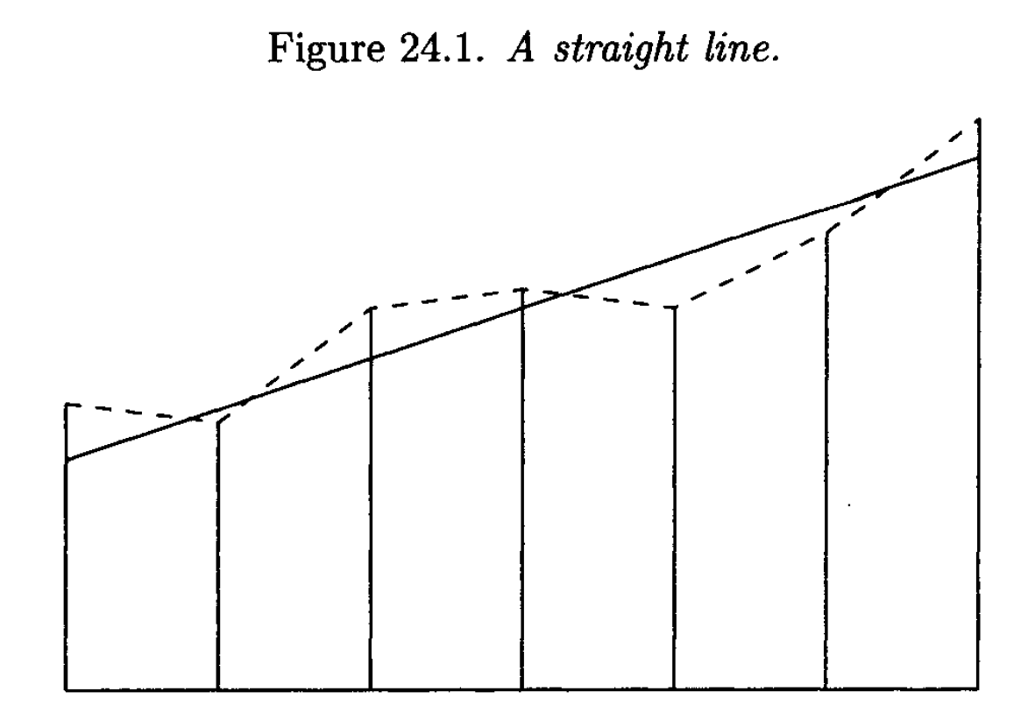
Differentiation vs Integration
Hoffman
Notes:
The exact derivative is constant along the entire range.
The approximate integral is relatively accurate with some intervals over approximating but others under approximating.
The derivative however, is all over the place!

Slide 6
Numerical Differentiation vs Numerical Integration
In general, numerical integration is much easier than numerical differentiation.
As we will see, numerical differentiation is subject to instability and errors that can not be reliably avoided.
However, we still often need to compute derivatives anyway so we’re stuck with it.

Slide 7
How can we approximate a derivative?
First, we need to know what information is available to us.
If we have a closed form equation for the function, we can ideally perform the differentiation explicitly.
We might also be able to use a symbolic differentiation application to do this for us.
However, we often only have access to a small subset of data points.
These might be tabulated data or the results of long costly computer simulations.
We can interpolate a polynomial.
We can use a finite difference formula.

Slide 8
Polynomial interpolation to approximate a derivative.
If we have a polynomial that interpolates or otherwise approximates a function or data, we can take the derivative of that polynomial.
That is, if we have polynomial $P(x)$ that approximates a function $f\left(x\right)$
$f(x)≅P(x)$,
we can approximate the derivative as
$$f^{′}\left(x\right)≅P^{′}\left(x\right).$$
We can also use this with non-polynomial functions that approximate a function of interest.
We might get these non-polynomial functions from a least squares fit.
What issues might we run into with this approach?

Slide 9
Example of polynomial interpolation for numerical differentiation
Sauer
Notes:
The interpolating function might not look anything like the underlying function.

Slide 10
Finite difference formulae
We know from elementary calculus that the derivative is given explicitly by,
$\frac{df}{dx}=f^{′}\left(x\right)=\lim_{h→0}{\frac{f\left(x+h\right)−f(x)}{h}}$.
Also recall the notation,
$$f_{x}\left(x\right)=\frac{df}{dx}=f^{′}\left(x\right)$$
Taylor’s theorem tells us that, if $f$ is twice differentiable,
$$f\left(x+h\right)=f\left(x\right)+hf^{′}\left(x\right)+\frac{h^{2}}{2}f′′(c)$$
where $c$ is between $x$ and $x+h$.

Slide 11
Two-Point Forward-Difference Formula
Rearranging, we obtain,
$f^{′}\left(x\right)=\frac{f\left(x+h\right)−f(x)}{h}−\frac{h}{2}f′′(c)$.
If $h$ is small, we can make the approximation,
$f^{′}\left(x\right)≅\frac{f\left(x+h\right)−f(x)}{h}$.
This is known as the two-point forward-difference formula.
The name is hopefully obvious.
It uses two points $f(x)$ and $f(x+h)$.
It looks ”forward” since it uses $\left(x+h\right).$
You take a difference to compute it.

Slide 12
Two-Point Forward-Difference Formula error
We typically treat the $\frac{h}{2}f^{′′}\left(c\right)$ as an error term.
As $h$ approaches 0, this will tend to 0.
There is one slight caveat here, if $h$ is changing, then so too might the constant $c$.
However, if $f^{′′}$ is continuous, the constant $f^{′′}(c)$ tends towards $f^{′′}(x)$ so we can still ensure convergence to 0.
Since our error contains an $h^{1}$ term, we say the formula is first order.
In general, if the error is $O(h^{n})$ we say that the function is an order $n$ approximation.

Slide 13
Two-Point Forward-Difference Formula error cont
Why do we even care about the error term if it contains a second derivative?
If we don’t have the first derivative, why would we have the second derivative?
Well, it can be useful to know how the error scales with $h$.
The $h$ term is often the only parameter we can change, so it can be useful to know that halving it can halve our error.
It’s also useful to check your code with an example you know the right answer to.
That way you can calculate the error explicitly and make sure your code is working properly.

Slide 14
Two-Point Forward-Difference Formula Example
Approximate the derivative of $f\left(x\right)=\frac{1}{x}$ at $x=2$ with $h=0.1$.
The formula is,
$$f^{′}\left(x\right)≅\frac{f\left(x+h\right)−f(x)}{h}$$
Plugging in values we get,
$$f^{′}\left(2\right)≅\frac{f\left(2+0.1\right)−f\left(2\right)}{0.1}$$
$$f^{′}\left(2\right)≅\frac{\frac{1}{2.1}−\frac{1}{2}}{0.1}≈−0.2381$$
The exact derivative is $f^{′}\left(2\right)=−\frac{1}{x^{2}}{\left.​\right|}_{x=2}=−0.25$

Slide 15
Two-Point Forward-Difference Formula Example cont
The error is thus
$$error=−0.2381−\left(−0.25\right)=0.0119$$
What is the expected error based on our error formula?
Well, the error formula is,
$$\frac{h}{2}f^{′′}\left(c\right)=\frac{0.1}{2}\frac{2}{c^{3}}=\frac{0.1}{c^{3}}$$
The $c$ parameter must be between $x$ and $x+h$ so the error is between,
$$\frac{0.1}{{(2.1)}^{3}}≤error≤\frac{0.1}{{(2)}^{3}}$$
$$0.0108≤error≤0.0125$$
This jives with our actual error.

Slide 16
Three-point centered-difference formula
Taylor’s Theorem tells us that if $f$ is three times differentiable,
$$f\left(x+h\right)=f\left(x\right)+hf^{′}\left(x\right)+\frac{h^{2}}{2}f^{′′}\left(x\right)+\frac{h^{3}}{6}f^{′′′}\left(c_{1}\right)$$
and
$f\left(x−h\right)=f\left(x\right)−hf^{′}\left(x\right)+\frac{h^{2}}{2}f^{′′}\left(x\right)−\frac{h^{3}}{6}f^{′′′}\left(c_{2}\right)$.
where $x−h<c_{2}<x<c_{1}<x+h.$
Let’s subtract these two equations and rearrange it,
$$f^{′}\left(x\right)=\frac{f\left(x+h\right)−f(x+h)}{2h}−\frac{h^{2}}{12}f^{′′′}\left(c_{1}\right)−\frac{h^{2}}{12}f′′′(c_{2})$$

Slide 17
Three-point centered-difference formula cont
We can use the Generalized Intermediate Value Theorem to write the equation as,
$$f^{′}\left(x\right)=\frac{f\left(x+h\right)−f(x−h)}{2h}−\frac{h^{2}}{6}f^{′′′}\left(c\right)$$
where $x−h≤c≤x+h$.
So, our approximation is,
$$f^{′}\left(x\right)≅\frac{f\left(x+h\right)−f(x−h)}{2h}$$
This is a second order formula to approximate the derivative $f^{′}\left(x\right)$.
Its name is also hopefully obvious.

Slide 18
Three-point centered-difference formula Example
Approximate the derivative of $f\left(x\right)=\frac{1}{x}$ at $x=2$ with $h=0.1$ using the three-point centered-difference formula.
The formula is,
$$f^{′}\left(x\right)≅\frac{f\left(x+h\right)−f(x−h)}{2h}$$
Plugging in,
$f^{′}\left(2\right)≅\frac{\frac{1}{2.1}−\frac{1}{1.9}}{0.2}≅−0.2506$.
The error is now only 0.0006!

Slide 19
Two- and Three-point formula Error
Both of these formulae are used widely by computationalists.
However, both of them break one of the main tenets of computation!
Don’t subtract nearly equal numbers.
Doing so can lead to loss of precision or issues that arise from rounding.
This can not be avoided.
Differentiation is inherently tricky for computers and can be incredibly unstable!

Slide 20
Higher order derivative approximations
We can apply the same basic approach to find higher order formulae or formulae for higher order derivatives.
Don’t confuse those two similar sounding terms.
For example, a three-point centered-difference formula for the second derivative is given by,
$$f^{′′}\left(x\right)=\frac{f\left(x−h\right)−2f\left(x\right)+f(x+h)}{h^{2}}−\frac{h^{2}}{12}f^{\left(4\right)}(c)$$
where $x−h≤c≤x+h$

Slide 21
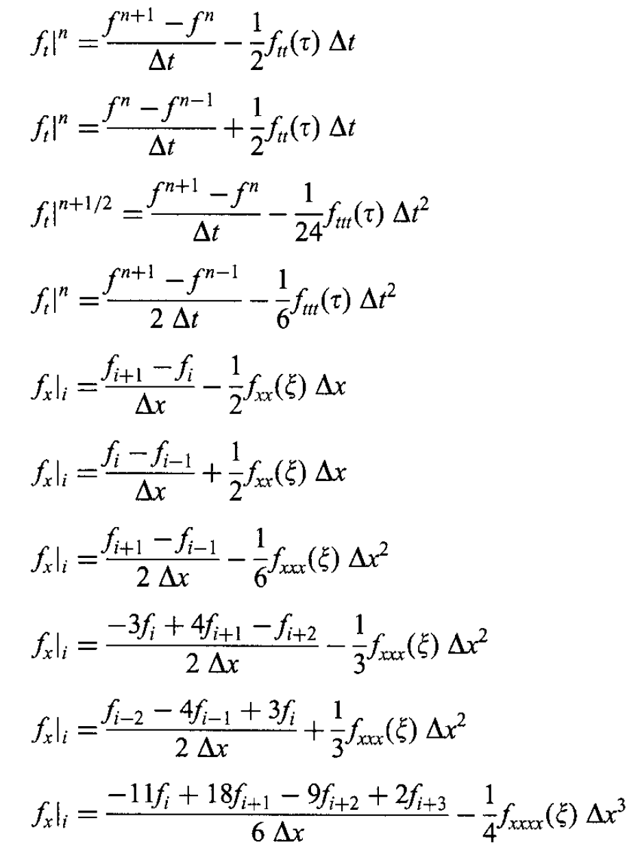
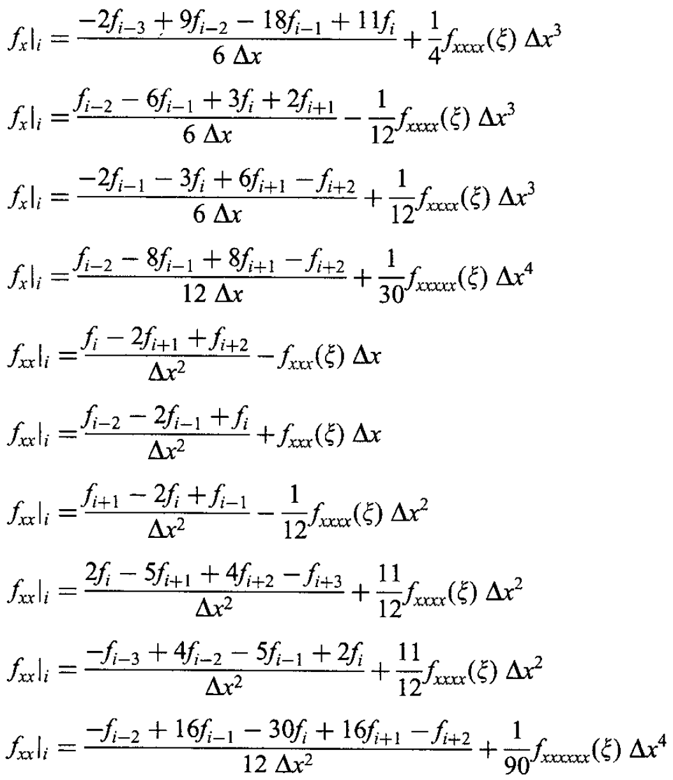
There are a lot of formulae to approximate derivatives…
Hoffman

Slide 22
A curious result
If we approximate the derivative of $f\left(x\right)=e^{x}$ at $x=0$, with the two- or three-point formulae, we expect the error to steadily decrease as we decrease $h$.
Let’s take a look.
Weird, right?
Sauer

Slide 23
Round off error
Why does the error start to go back up when $h$ is made very small?
We are subtracting numbers that are nearly equal.
This leads to loss of precision which is made worse when we divide by the very small $h$.
More rigorously,
$$f^{′}{\left(x\right)}_{analytic}−f^{′}{\left(x\right)}_{numeric}=f^{′}\left(x\right)−\frac{f{\left(x+h\right)}_{floating}−f{\left(x−h\right)}_{floating}}{2h}$$
$$=f^{′}\left(x\right)−\frac{f\left(x+h\right)+ε_{1}−(f\left(x−h\right)+ε_{2})}{2h}$$
$$=\left(f^{′}\left(x\right)−\frac{f\left(x+h\right)−f\left(x−h\right)}{2h}\right)+\frac{ε_{2}−ε_{1}}{2h}$$
$$f^{′}\left(x\right)−f^{′}{\left(x\right)}_{numeric}+rounding error$$

Slide 24
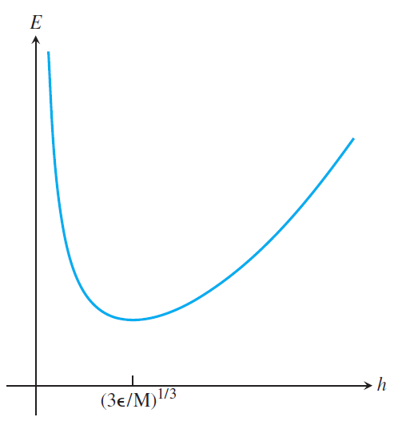
Round off error
The total error in our calculation comes from truncation, rounding error, and the error in our approximation.
The rounding error is bounded by
$$\left|\frac{ε_{2}−ε_{1}}{2h}\right|≤\frac{2ε_{mach}}{2h}=\frac{ε_{mach}}{h}$$
The error as a function of $h$ is bounded by
$E\left(h\right)=\frac{h^{2}}{6}f^{′′′}\left(c\right)+\frac{ε_{mach}}{h}$.
If we make the approximation $C≈|f^{′′′}\left(c\right)|≈|f′′′(x)|$ we can find the minimum of the error by solving,
$$0=E^{′}\left(h\right)=−\frac{ε_{mach}}{h^{2}}+\frac{C}{3}h$$
The solution is $h={\left(\frac{3ε_{mach}}{C}\right)}^{\frac{1}{3}}$.
Sauer

Slide 25
Richardson Extrapolation
If we have an order $n$ formula, $F(h)$, that approximates some quantity $Q,$
$$Q≈F\left(h\right)+Ch^{n}$$
where C is approximately constant over some range of h, we can improve the order of the approximation.
We do this using Richardson Extrapolation,
$$Q≈\frac{2^{n}F\left(\frac{h}{2}\right)−F\left(h\right)}{2^{n}−1}$$
This gives a formula that is, at least, of order $n+1$.
This is one way to generate the large table of derivative approximations I showed before.

Slide 26
Multivariable Derivative Approximation
We’ve only looked at functions of a single variable so far.
These sorts of functions are incredibly common.
However, we are sometimes interested in differentiating functions of multiple variables.
If we want to find the derivative wrt $x$ of a multivariable function we can simply use,
$f_{x}\left(x,y\right)≅\frac{f\left(x+h,y\right)−f(x,y)}{h}$.
Similarly for the y derivative.

Slide 27
Mixed Derivative Approximation
If instead we want to approximate the mixed derivative of a multivariable function we can use,
$$\frac{∂^{2}f}{∂x∂y}≈\frac{\frac{∂}{∂y}f\left(x+h_{1},y\right)−\frac{∂}{∂y}f\left(x−h_{1},y\right)}{2h_{1}}$$
where,
$$\frac{∂}{∂y}f\left(x+h_{1},y\right)≈\frac{f\left(x+h_{1},y+h_{2}\right)−f(x+h_{1},y−h_{2})}{2h_{2}}$$
and
$$\frac{∂}{∂y}f\left(x−h_{1},y\right)≈\frac{f\left(x−h_{1},y+h_{2}\right)−f(x−h_{1},y−h_{2})}{2h_{2}}$$

Slide 28
Mixed Derivative Approximation cont
All together now!
$$\frac{∂^{2}f}{∂x∂y}≈\frac{\frac{f\left(x+h_{1},y+h_{2}\right)−f(x+h_{1},y−h_{2})}{2h_{2}}−\frac{f\left(x−h_{1},y+h_{2}\right)−f(x−h_{1},y−h_{2})}{2h_{2}}}{2h_{1}}$$
Simplifying a bit,
$$\frac{∂^{2}f}{∂x∂y}≈\frac{f\left(x+h_{1},y+h_{2}\right)−f\left(x+h_{1},y−h_{2}\right)−f\left(x−h_{1},y+h_{2}\right)−f(x−h_{1},y−h_{2})}{4h_{1}h_{2}}$$
You often see this notated as
$$\frac{∂^{2}f}{∂x∂y}≈\frac{f_{1,1}−f_{1,−1}−f_{−1,1}+f_{−1,−1}}{4h_{1}h_{2}}$$
The error of this approximation is proportional to $h_{1}^{2}h_{2}^{2}$

